Slide 1

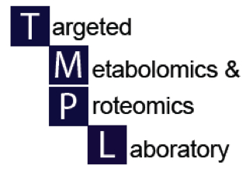

Introduction to metabolomics research
UAB Metabolomics Workshop
December 2, 2015
Stephen Barnes, PhD
Director, TMPL

Slide 2
Who’s applying metabolomics at UAB?
Lalita Shevde-Samant – Merlin and Cancer Cell metastasis
Adam Wende – Cardiac mitochondrial dysfunction
Haley Albright/John Hartman – A yeast aging model
Victor Darley-Usmar – Inhibition of cancer cell growth
Michael Miller/Jeevan Prasain – Novel oxylipids in C. elegans
Clinton Grubbs – Co⁶⁰ radiation of the diet and reduction in mammary tumors in a rat model of breast cancer
Mamie McLean/Lori Harper – Obesity and diabetes in women
Matt Stoll – Fecal metabolome in children with arthritis
Peter Mannon – Fecal microbiome in Crohn’s disease
Charitharth (Vivek) Lai – Lung metabolomics in the newborn
Gang Liu - Metabolic Reprogramming in Myofibroblasts as a Mechanism of Pulmonary Fibrosis

Slide 3
Funded studies at RTI Intl
Environmental Impact of Metabolomics on Food Allergy
Metabolomics in Fetal Programming
Small Cell Lung Cancer Metabolome
Metabolomic Profiling of Influenza
Role of Microbial Metabolites in Experimental Liver Disease
Metabolic Microenvironments in Normal Breast and Breast Cancer
Merging Metabolomic Signatures and Epigenetic Regulators from Blood to Predict Sepsis
Metabolomic Profiling of Kinase Inhibitor Responses in Leukemia
Biomarker Discovery in Knee Osteoarthritis
Genetic Effects of High Fat Diet on Mouse Fecal Metabolomics
Metabolomics Involved in Early Life Antibiotic Exposures
Correlation of Urine Metabolomics Profile with eGFR, ACR and Dietary Acid Load in Elderly and non-Elderly Patients with Chronic Kidney Disease
Diabetes and the Cori Cycle
Biomarkers of Serotonin and Dopamine (SaD) Modulation in Depression-Schizophrenia (MinDS): Tobacco Use Interactions in Treatment Benefit and Side-Effect Profile

Slide 4
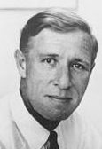
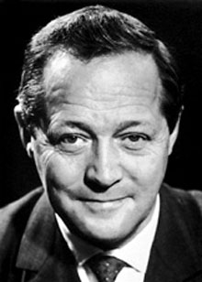
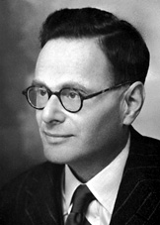
Metabolomics and NIH Research 1950-2015
Metabolomics
1950s-60s emphasis on determining metabolic pathways – 20+ Nobel prizes
1950s-early 1980s Identification and purification of proteins
2014 –”deep” proteomics reveals the presence of 400+ proteins that are not encoded by the genome
1980-1988 Sequencing of genes – cDNA libraries –orthogonal research
Bloch Lynen Krebs
2012 Human genome ENCODE project reveals the extent of DNA expression and roles for “junk” DNA, as well as intergenic proteins
1988-2000 Sequencing of the human genome – period of non-orthogonal research – where did all the genes go? junk DNA?
2006 First ENCODE project on 1% of the human genome reveals RNAs coming from more than one gene
2004 Tiling arrays reveal that most of the genome is expressed
Notes:
Add microbiome

Slide 5
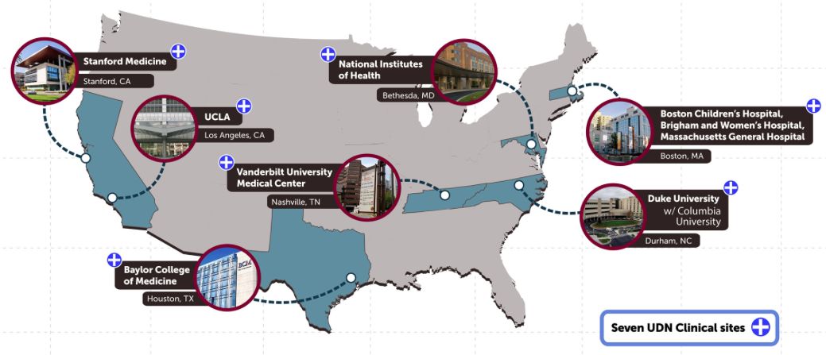
NIH UDN initiatives
DNA sequencing
Small animal models
Metabolomics

Slide 6

Molecular transducers of physical activity
NIH Common Fund opportunities
Submission deadline March 18, 2016
Molecular Transducers of Physical Activity Genomics, Epigenomics and Transcriptomics Chemical Analysis Sites (U24)
(RFA-RM-15-010)
Molecular Transducers of Physical Activity Metabolomics and Proteomics Chemical Analysis Sites (U24)
(RFA-RM-15-011)
Molecular Transducers of Physical Activity Bioinformatics Center (U24)
(RFA-RM-15-012)
Molecular Transducers of Physical Activity Preclinical Animal Study Sites (U01)
(RFA-RM-15-013)
Molecular Transducers of Physical Activity Consortium Coordinating Center (CCC) (U24)
(RFA-RM-15-014)
Molecular Transducers of Physical Activity Clinical Centers (U01)
(RFA-RM-15-015)

Slide 7
What are the goals of metabolomics?
The metabolites are the fuel and messengers in and between cells in an organized system
  Messengers as distinct from message
To identify the critical metabolite or combination of metabolites that is(are) associated with a particular phenotype
  The metabolite(s) may be known, or need to be characterized

Slide 8
Can we predict the metabolome from DNA/mRNA sequence information?
Can we predict the proteome from DNA/mRNA sequence information?

Slide 9
Predicting the metabolome
Predicting the proteome was a logical translation of sequencing the genomes
  Computers (largely) were able to identify open reading frames
  Knowing the start sites and codons, the amino acid sequence for known and putative proteins could be interpreted
At this time, we cannot predict the metabolites made by enzymes
  Rely on existing pathway information and annotations
  Metabolomics is re-writing our knowledge of pathways

Slide 10
Metabolites are associated with every aspect of cellular events
+ methylation
deoxyribonucleotides
Genome
Metabolite regulation
miRNAs
Metabolites
ribonucleotides
Transcriptome
Amino acids, ATP
lncRNAs
Cofactor regulation
Enzymes
Proteins
Chromatin
Transcription factors
Transporters
Structural
Signaling
+ methylation
Activation
ATP, c-AMP, c-GMP
turnover

Slide 11
The metabolome is more than just metabolites
The metabolome is considered to be all molecules with masses up to 1,500 Da
  These molecules can come from ‘genomes’ other than the model you’re studying
    Foods, particularly plants, that form the diet
    Gut microorganisms
    Environmental contaminants
    Therapeutics and their metabolites
Exposome
  The integrated exposure to all metabolomes over your lifetime

Slide 12
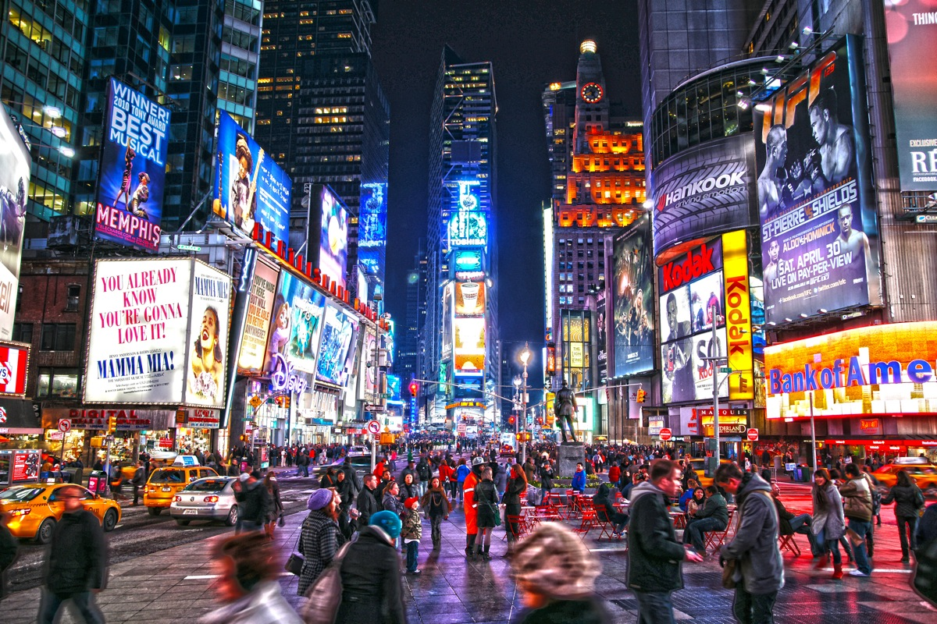
The metabolome is very complex!

Slide 13
Metabonomics is a term coined by those pioneering NMR metabolomics

Slide 14
Metabolomics workflow
What is the question and/or hypothesis?
Samples – can I collect enough and of the right type?
Storage, stability and extraction
Validation of the metabolite ID
  MSMS
Database search to ID significant metabolite ions
Choice of the analytical method
  NMR
  GC-MS
  LC-MS
Pathway analysis and design of the next experiment
Statistical analysis
  Adjusted p-values
  Q-values
  PCA plots
Data collection
Pre-processing of the data

Slide 15
The Cloud and computing in 2016
NIH is increasing its demands re data availability
The manufacturers are turning to putting software and your data into the Cloud (assuming you can overcome HIPPA constraints)
In proteomics, they are putting their programs there
  SCIEX is using BASESPACE (with Illumina)
  You upload your data to an Amazon server
  The programs are downloadable Apps
For now, metabolomics uses XCMS
  Either online or as a server-based software
  Cloud next?

Slide 16
Great challenges in metabolomics
The extent of the metabolome
  From gaseous hydrogen to earwax
  A much wider range of chemistry than the genome, epigenome and transcriptome, and the proteome
Having complete databases
  METLIN has 60,000+ metabolite records, but your problem always creates a need to have more
  Current lack of a substantial MSMS database (but it’s coming)
Storing and processing TBs/PBs of data
Standards and standard operating procedures
Being able to do the analyses in “real time”

Slide 17
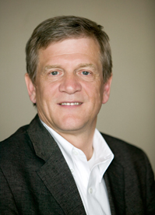
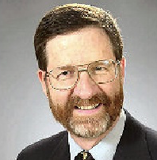
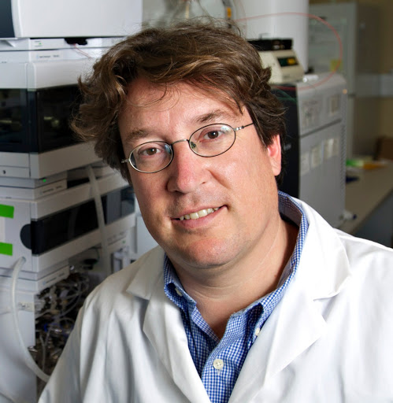
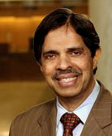
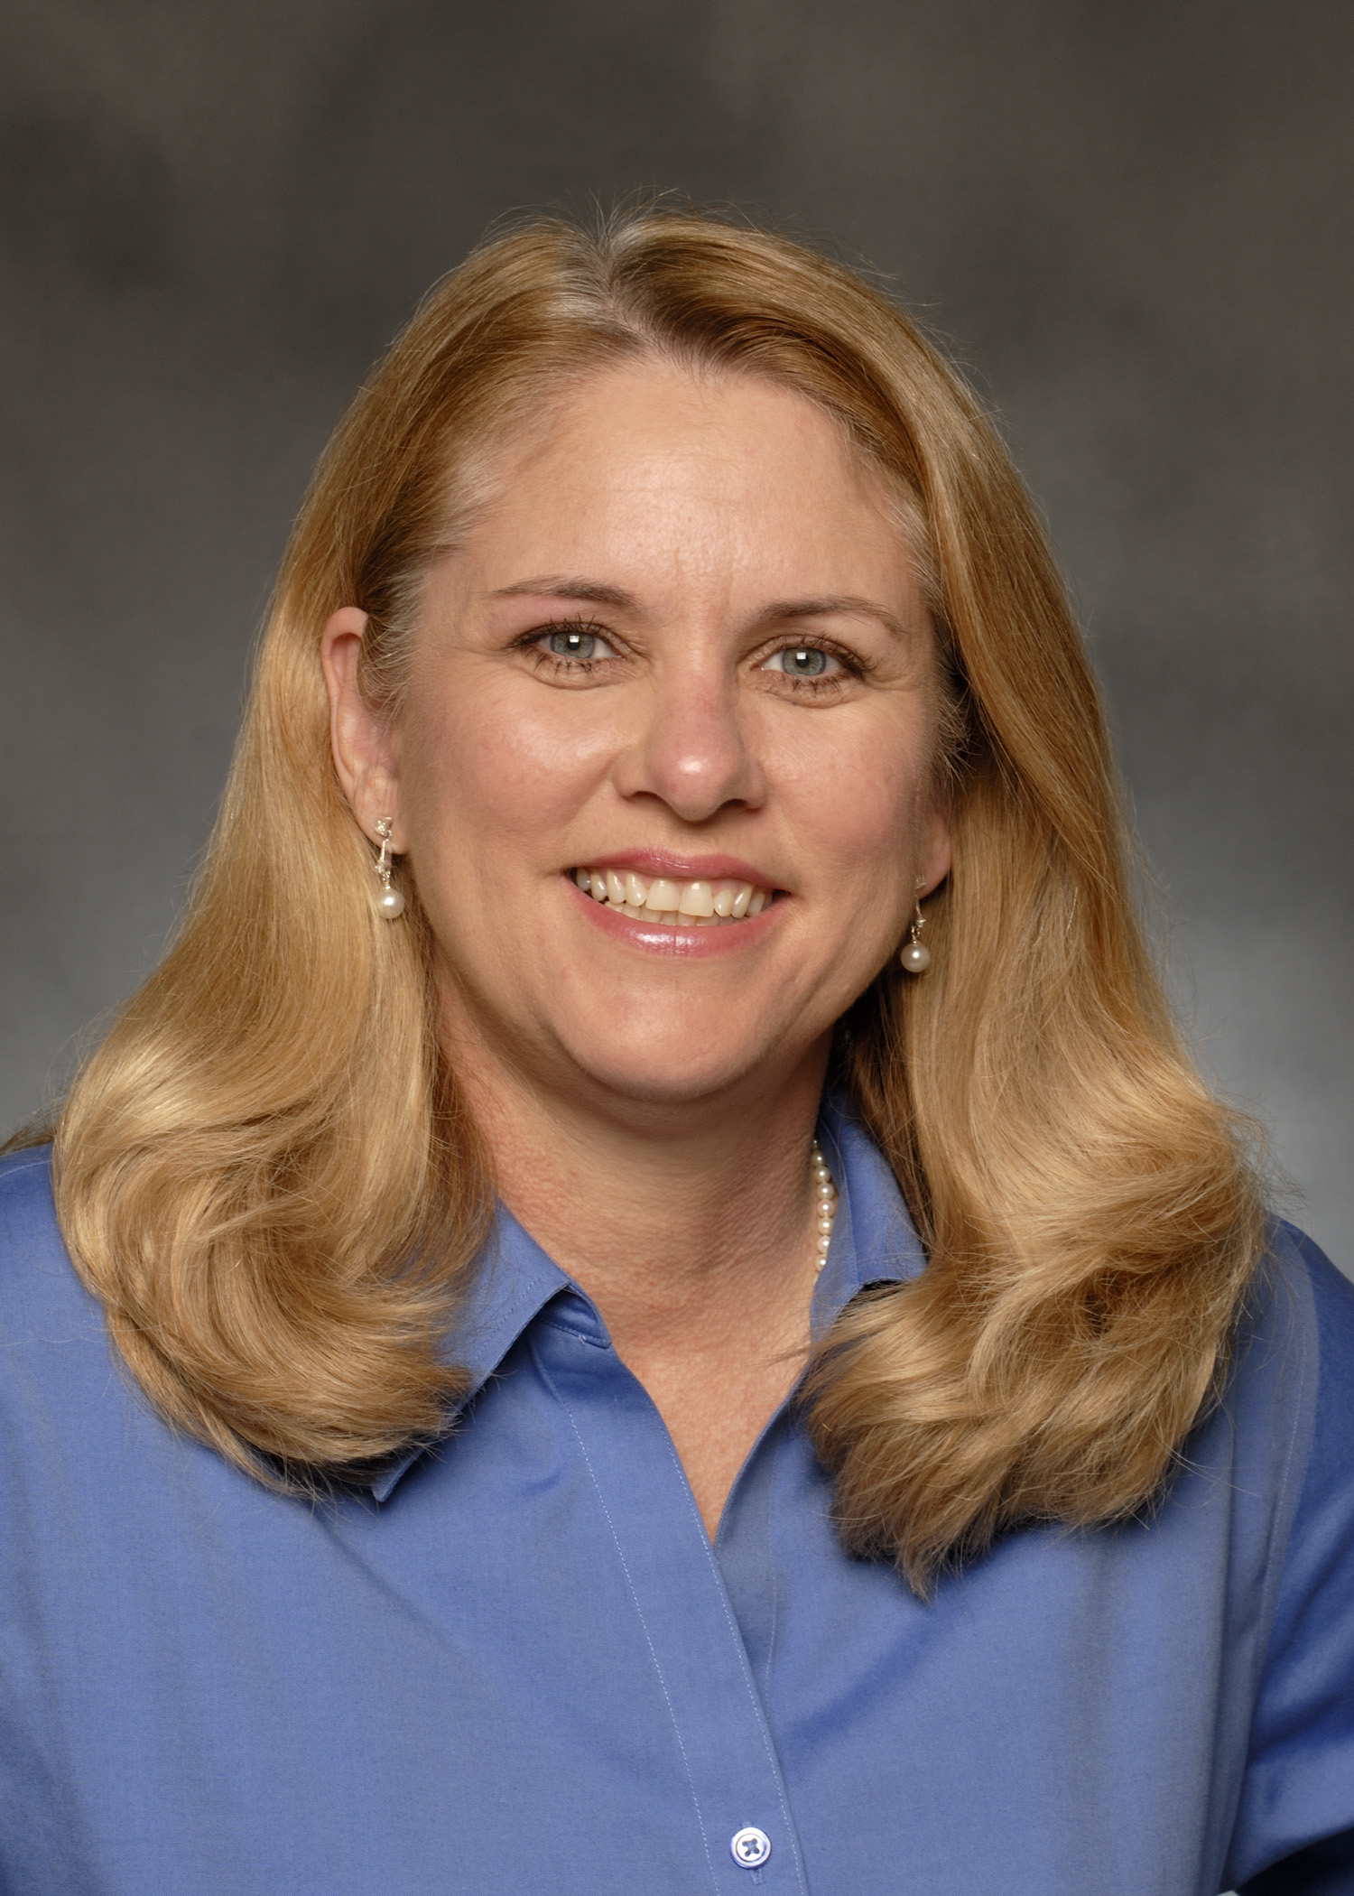
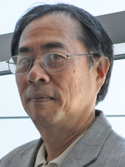
NIH Regional metabolomics centers
Charles Burandt
MRC2
U. Michigan
Rick Yost
SECIM
U. Florida
NIH Common Fund Regional Comprehensive Metabolomics Research Centers
Oliver Fiehn
UC-Davis
Sreekumaran Rao
Mayo Clinic
Susan Sumner
RTI International
Rick Higashi
U. Kentucky
http://www.metabolomicsworkbench.org
Each of these regional centers has a pilot program, typically up to $50k with annual deadlines in mid-February (last one in 2016)

Slide 18
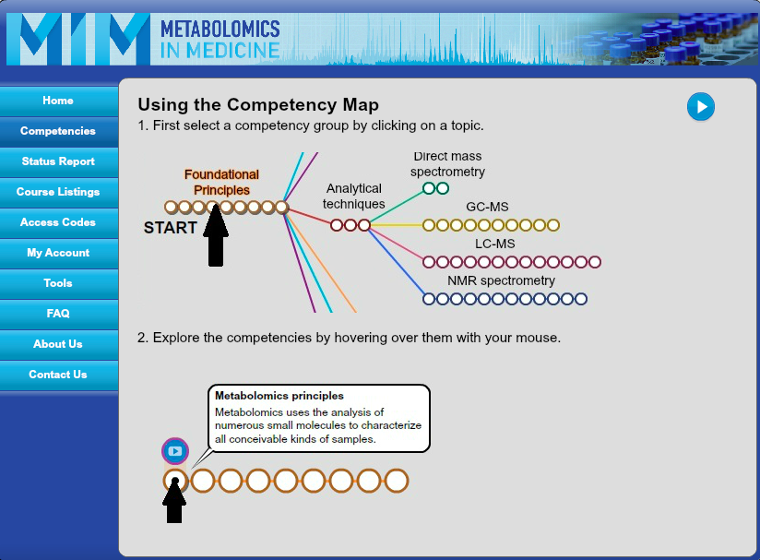
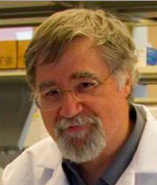
http://metabolomicsinmedicine.org/portal/
Martin Kohlmeier

Slide 19
https://www.youtube.com/user/MetabolomicsMI
Other resources in metabolomics
http://www.uab.edu/proteomics/metabolomics/workshop/workshop_june_2015.php

Slide 20
Workflow for metabolomics training
RTI, SECIM, Michigan, Mayo
Kohlmeier
Want to read more
Symposia
Mar/May/Sep 2016
Metabolomics portal
Level of experience
Hands-on workshops
UAB LC-MS/NMR
SECIM NMR
June/May, 2016
Kentucky
Fluxomics
UC-Davis GC-MS, QC
Metabolomics Workbench
Advanced hands-on
Data analysis
advanced
Imaging
Metabolomics
UC-Davis
July/Sep 2016
Vanderbilt U
Feb 2016
Mar 2016

Slide 21

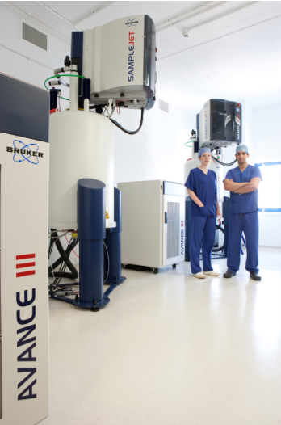
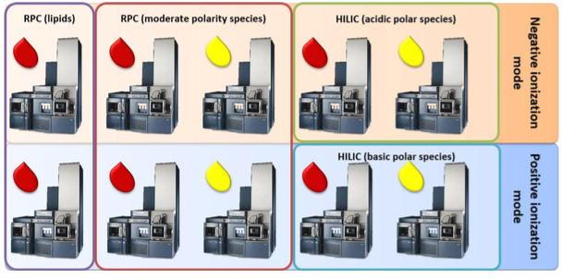
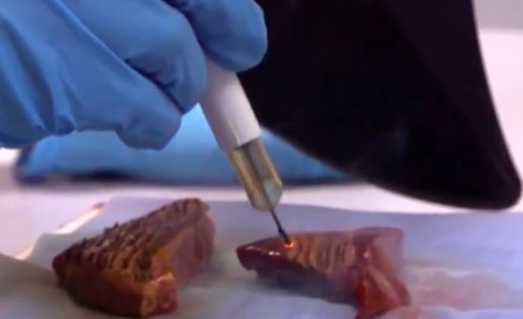
Mass spectrometers (10 Q-TOFs) each dedicated to one assay format
600 MHz NMR instruments in surgical suite
Iknife - revolutionizing surgery
This is Next-GEN precise medicine

Slide 22
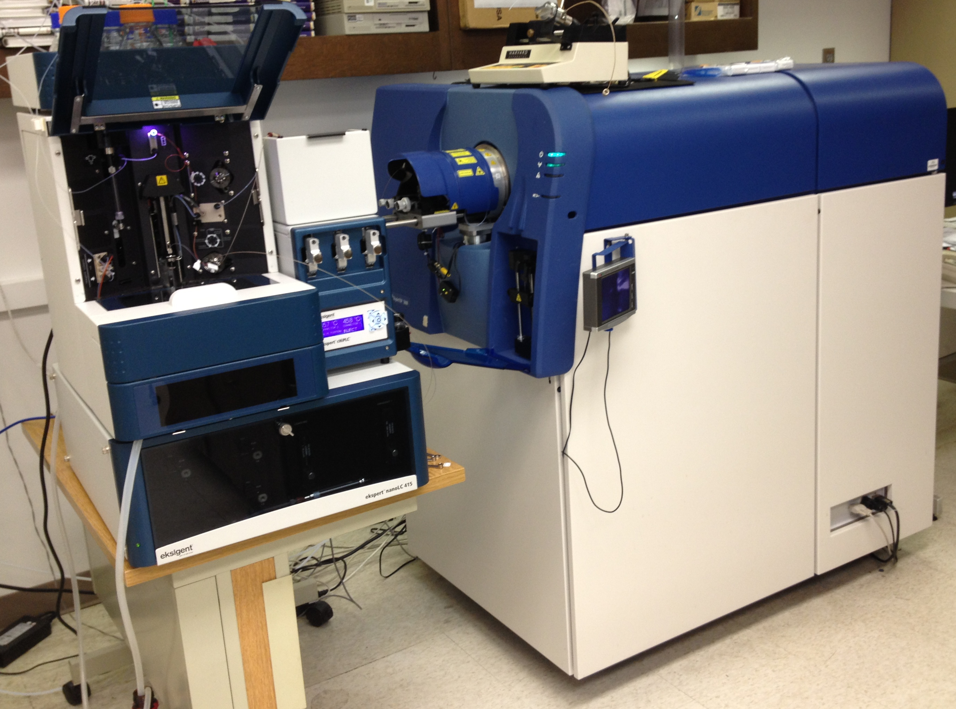
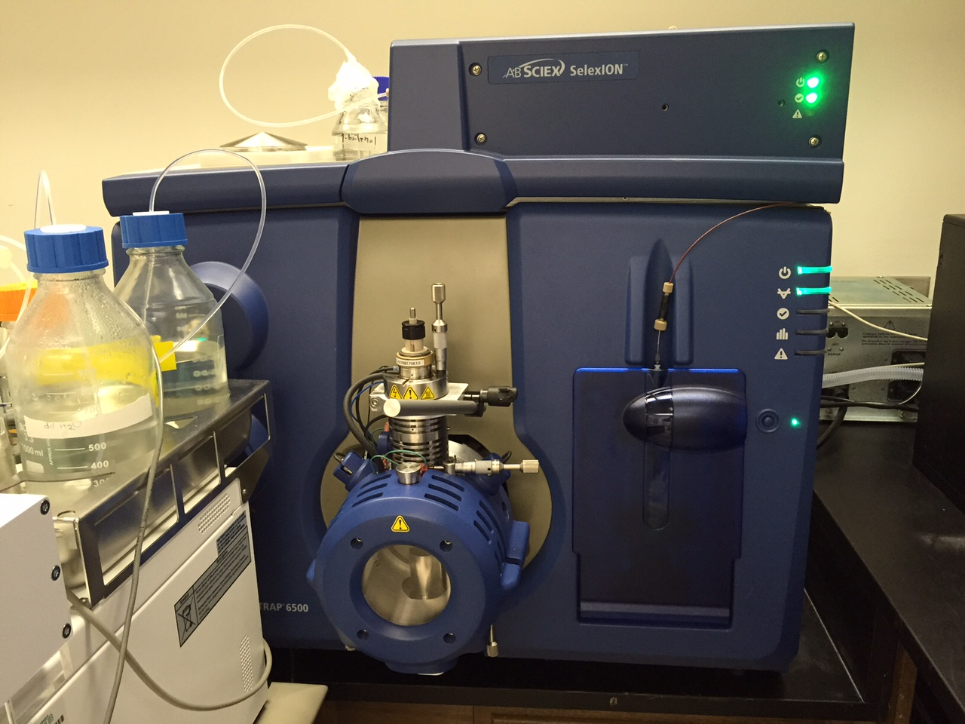
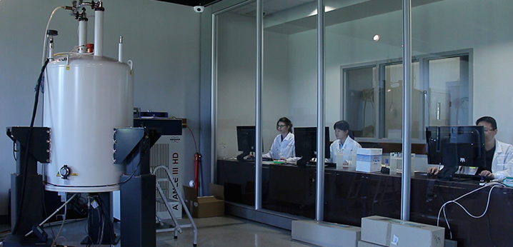
UAB capabilities
TMPL mass spec lab
MCLM 459/427
Stephen Barnes, Director
934-7117/3462
SCIEX 5600 TripleTOF
with Eksigent nanoLC
SCIEX 6500 Qtrap with SelexION
Central Alabama NMR facility
Chemistry Bdg
N. Rama Krishna, Director
934-5695

Slide 23
Graduate level course in metabolomics
GBS 724
Starts Monday, January 4, 2016
  Meets from 11 am to 12:30 pm on Mondays, Wednesdays and Fridays
  Room 515, Shelby Bdg
Besides UAB colleagues, it features talks from colleagues at HudsonAlpha, Penn State, RTI International and Scripps Research Institute

Slide 24
Structure of Today’s workshop
Introduction to experimental design
  Optimal planning and sample collection
Sample processing/extraction
Primary data collection by NMR, LC-MS and imaging
Introduction to data processing and statistical analysis
Introduction to advanced data processing; data interpretation and pathway analysis
Integration of metabolomics and its future

